Slide 1

Save
Water
SAVE LIFE
Every Drop Counts
Presented by: Khushi Maurya
Trade: AIPA
Batch: 2026-2027

Slide 2
01
Water
Conservation
Why saving water is important?

Slide 3
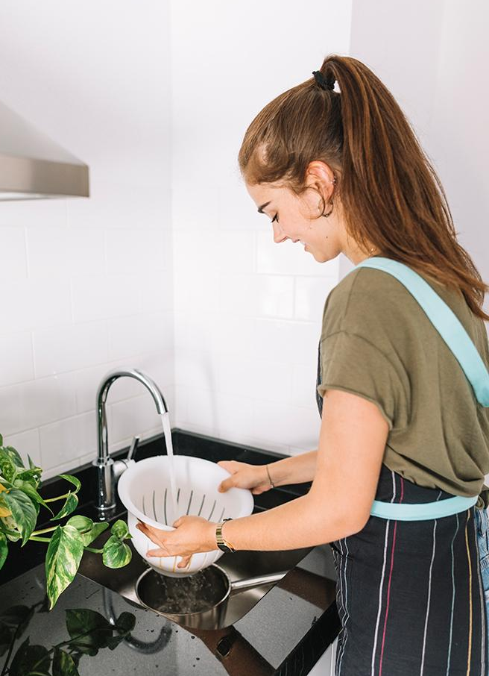
Why Water Conservation Matters?
Water is essential for life.
Fresh water is limited and must be used wisely.
Saving water helps protect our environment.
Small changes in daily habits can save many liters of water.

Slide 4
Water Scarcity
Cause of Water Scarcity
Efeects of Water Scarcity
Population growth and increasing water demand put pressure on limited freshwater resources. Climate change, pollution and overuse of groundwater can also reduce water availability.
Water scarcity can affect agriculture, industries and daily life. It may lead to droughts, reduced food production and competition for available water resources.

Slide 5
Water Conservation in Action
Save Water at Home
Save Water at School
Community Action
Turn off taps when not in use.
Fix leaking taps and pipes quickly.
Use a bucket instead of a long shower.
Reuse water for plants and cleaning.
Close taps properly after use.
Avoid wasting drinking water.
Report leaking taps immediately.
Encourage others to save water.
Spread awareness about water conservation.
Collect and reuse rainwater.
Keep water sources clean.
Work together to protect water resources.

Slide 6
Water Saving Tips
Fix Leaks
Rainwater Harvesting
Spread Awareness
Check taps and pipes regularly. Repair leaks as soon as possible. Prevent water from being wasted.
Collect rainwater for reuse. Store it safely for later use. Use it for gardening and cleaning.
Tell others about water conservation. Encourage friends and family to save water. Share useful water-saving ideas.
Reuse Water
Smart Water Use
Daily Action
Reuse water whenever possible. Use leftover water for plants. Avoid unnecessary wastage.
Use a bucket instead of a long shower. Run washing machines with full loads. Turn off taps when not needed.
Make water saving a daily habit. Reduce water wastage every day. Protect water for the future.

Slide 7
Water Scarcity: Latest Updates
Government Initiatives
Community Action
Government is promoting rainwater harvesting, water conservation and efficient use of water resources to reduce water scarcity.
Local communities are working together to save water, protect water sources and spread awareness about conservation.
New Technologies
Awareness Compaigns
Smart water meters, drip irrigation and water recycling technologies are helping reduce water wastage and improve water management.
Schools and organizations are conducting campaigns to encourage people to save water and adopt responsible water-use habits.

Slide 8
—Our responsiblity
“Every Drop Counts. Save Water Today, Secure Tomorrow.”

Slide 9
April 22
June 5
March 22
Earth Day: A day to promote environmental protection and sustainable use of natural resources.
World Environment Day: Promotes awareness and action to protect our environment and conserve natural resources.
World Water Day: Raises awareness about the importance of freshwater and the need to manage water resources responsibly.

Slide 10
Water Conservation Priorities
Rainwater Harvesting
Reuse Water
Smart Water Use
Awareness Campaigns

Slide 11
Are Our Water-Saving Efforts working?
Product | Price | Discount | Availability | Comments | Rating
Rainwater Harvesting kit | ₹2,000 | 10% off | Available | “Very useful” | 4/5
Water-Saving Tap | ₹800 | No discount | Available | “Work well” | 4/5
Drip Irrigation Kit | ₹1500 | 15% off | Available | “Save water” | 5/5
Water-Level Sensor | ₹1200 | No discount | Available | “Quite Useful” | 4/5
Water Recycle System | ₹5,000 | 20% off | Available | “Very Effective” | 5/5
Low-Flow Shower | ₹1,000 | 5% off | Available | “Practical” | 4/5

Slide 12
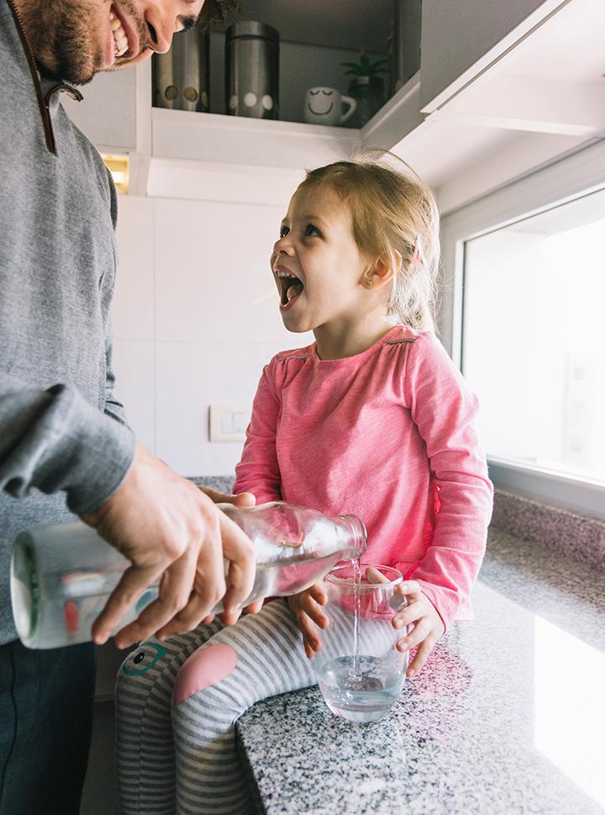
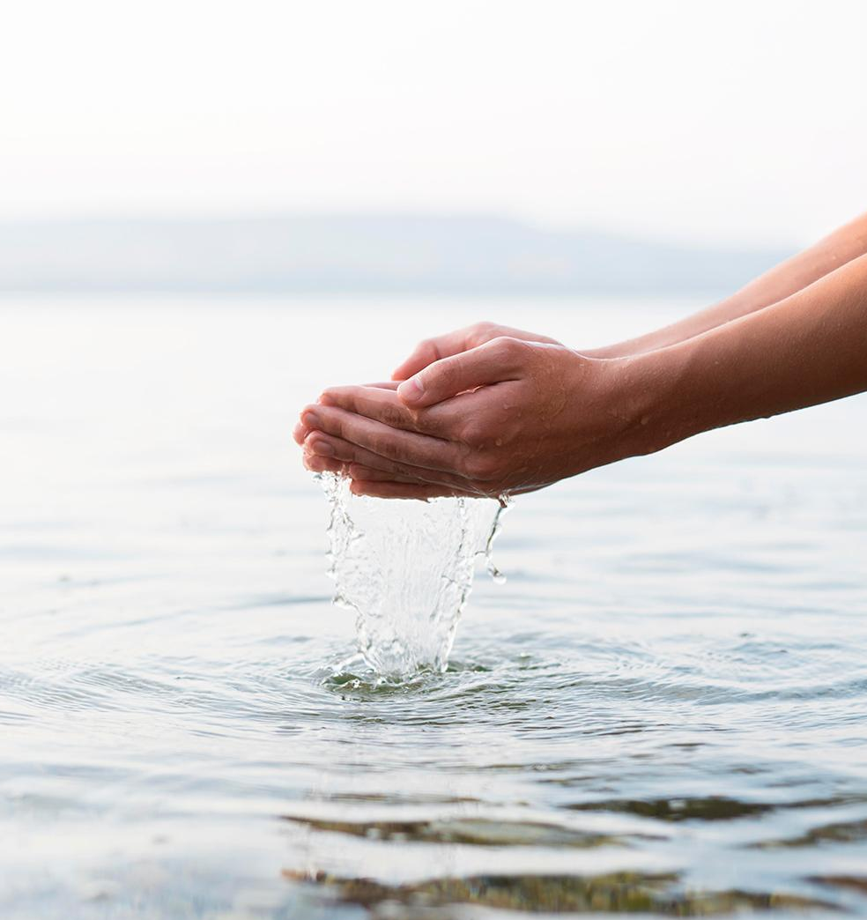
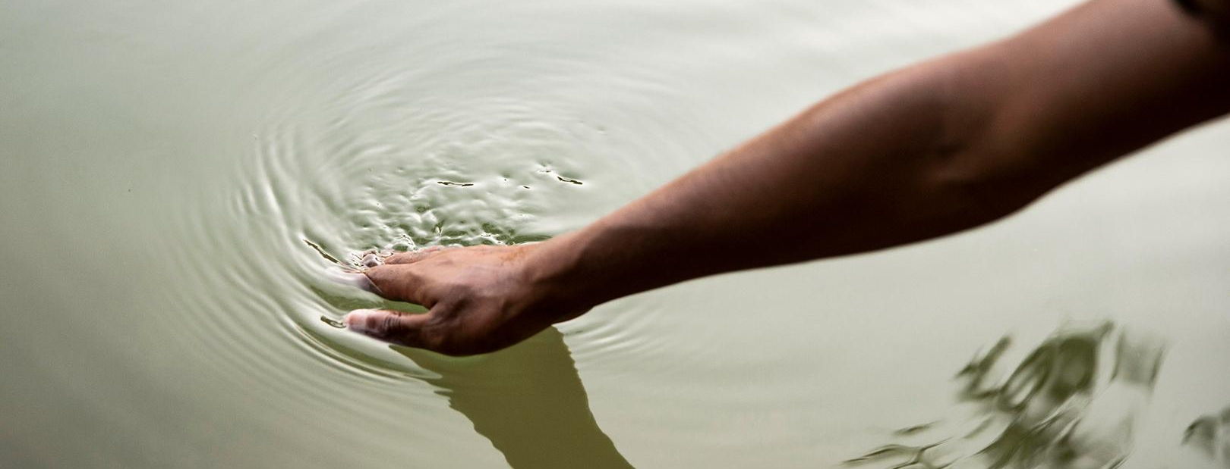
Water-Saving moments
Save water today for a better tomorrow. Every small step towards water conservation makes a difference.

Slide 13
Our Water Conservation Plan
Identify Water Wastage
Save & Reuse Water
Use Water-Saving Methods
Spread Awareness
Create a Sustainable Future

Slide 14
Thank You
Every Drop Counts — Save Water, Save the Future.

